Slide 1

Register
Presented by: Asst. Prof. Shipra sharma
PG Dept. of Cs & It
Doaba College Jalandhar

Slide 2
What is Register
A register is one which registers/stores/remembers data. Since a flip-flop stores 1-bit data, it is called a 1-bit register. In any practical application, it is required to store large amount of data. So, a practical register stores multi-bit data.

Slide 3

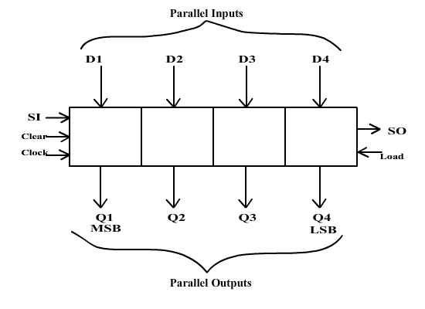
Example
(D1 D2 D3 D4) is 4-bit parallel input to the register i.e. using these four lines, we can put 4-bit data into register simultaneously. (Q1 Q2 Q3 Q4) is parallel output from register i.e. 4-bit data can be retrieved from these lines. SI is serial input from which data can be entered bit-by-bit while SO is serial output from which data can be retrieved bit-by-bit. Load input is used to load data parallel while Clear is used to reset all the bits in register to LOW. Clock facilitates all these operations. Clock could be level or edge triggered depending on design requirements.

Slide 4
Shift Register
Shift Registers are used for data storage or for the movement of data and are therefore commonly used inside calculators or computers to store data such as two binary numbers before they are added together, or to convert the data from either a serial to parallel or parallel to serial format.
IC’s are generally provided with a clear or reset connection so that they can be “SET” or “RESET” as required. Generally, shift registers operate in one of four different modes with the basic movement of data through a shift register being:

Slide 5
Modes of Data Shifting
Serial In Serial Out (SISO)
Serial In Parallel Out (SIPO)
Parallel In Serial Out (PISO)
Parallel In Parallel Out (PIPO)

Slide 6
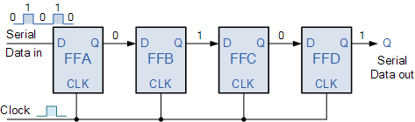
Serial In Serial Out (SISO)
Serial-in to Serial-out (SISO) - the data is shifted serially “IN” and “OUT” of the register, one bit at a time in either a left or right direction under clock control.
4-bit Serial-in to Serial-out Shift Register

Slide 7
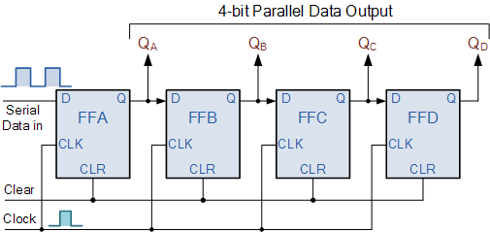
Serial In Parallel Out (SIPO)
Serial-in to Parallel-out (SIPO) - the register is loaded with serial data, one bit at a time, with the stored data being available at the output in parallel form.
4-bit Serial-in to Parallel-out Shift Register

Slide 8
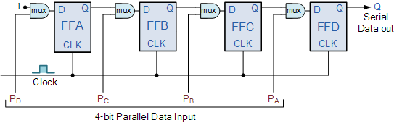
Parallel-in to Serial-out (PISO)
Parallel-in to Serial-out (PISO) - the parallel data is loaded into the register simultaneously and is shifted out of the register serially one bit at a time under clock control.
4-bit Parallel-in to Serial-out Shift Register

Slide 9
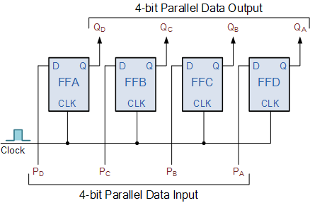
Parallel In Parallel Out (PIPO)
the parallel data is loaded simultaneously into the register, and transferred together to their respective outputs by the same clock pulse.
4-bit Parallel-in to Parallel-out Shift Register

Slide 10
References:
https://www.electronics-tutorials.ws/sequential/seq_5.html https://www.geeksforgeeks.org/shift-registers-in-digital-logic/

Slide 11
Thank You!

